Slide 1

AgentScore
Weekly update
Oct 29 - Nov 4, 2026
AgentScore Weekly Update
Week of November 9, 2026
Beta Cohorts and External Interest as of Nov 4, 2026.

Slide 2

AgentScore
Weekly update
Oct 29 - Nov 4, 2026
This week in four answers
Detail on the slides that follow
WHO IS USING IT
WHAT IS STOPPING ONBOARDING
FEEDBACK FROM PEOPLE USING IT
WHAT IS NEXT
1 customer live, 1 internal agent scoring
Most invites go unanswered
Users ask what comes after the score
Get every user to a first score
External
Tritusa is live and using the product.
Wolters Kluwer reported logged in, nothing run yet.
Internal
Tosca agent (ATA) is scoring.
Performance Agent, Quality Agent and the chatbot are in progress.
Lack of customers
Invites go largely ignored: 7 of 9 invited accounts have no sign-in reported.
On-prem requirement
Eaton and Merito need an on-prem answer before they can start.
Suspected onboarding difficulty
Wolters Kluwer signed in but has not run anything.
Tritusa scored well
Ran its agents with proper traces. Now wants training on how scores are built and how to find failures.
Top asks across accounts
Simulation testing (6 accounts) and scoring a group of agents (5).
From Tritusa's email and the Customer Feedback Log.
Simpler onboarding
Make it incredibly simple and easy to get a first score.
Every internal agent
Onboard every internal Tricentis agent.
Spikes
JEV / decision models and stimulation testing.
Beta Cohorts and External Interest, Nov 4. Working sessions Oct 29, Nov 2, Nov 3. Customer Feedback Log. Roadmap Nov 4 (draft).

Slide 3
AgentScore
Weekly update
Oct 29 - Nov 4, 2026
Who is using it
2 external accounts signed in, 1 internal agent scoring. As of Nov 4
EXTERNAL CUSTOMERS
INTERNAL TRICENTIS AGENTS
Tritusa
Tosca agent (ATA)
Live. Use reported Nov 4. In the product by Oct 22.
Onboarded and scoring.
Use case Evaluate the agents they build for clients, and run their assurance practice. They showed a Copilot Studio agent and an AI Workspace agent, each turning a requirements document into Tosca.
Still open Compliance checks for bank and pharma clients. Alerting when an agent degrades. An export of traces and scores.
Why it works Its service was instrumented on purpose, so traces attribute to the agent and the score comes out as designed.
Next Improving the evaluations and results, auditing/comparing with an AI Engineer’s evaluations
Wolters Kluwer
Not scoring yet
Reported logged in Nov 4. Nothing run yet.
No instrumentation guide for the owning teams yet.
Use case Score agents outside Tricentis, on their FAB platform and in GitHub Copilot, and use the scores to steer people to sanctioned tools.
Status Reported Nov 4 as signed in with nothing run. Beta Cohorts still says no sign-in, so the tracker needs the date.
Performance Agent service.name is not set, so the agent never appears.
Quality Agent Not one agent. Its pieces are called by the chatbot graph.
AI chat and the chatbot Traces do not line up with the service list.
Smith (TAIS) Live in dev only. Tim is checking its traces carry the attributes AgentScore needs.
External: 7 of 9 invited have no sign-in reported. Invited Oct 12: Merito, L'Oréal, Aptiv, New Vision. Invited Nov 2: Eaton, BearingPoint, Workday. Pending beta: Accenture.
Internal: Nov 2 and Nov 3 working sessions.

Slide 4
AgentScore
Weekly update
Oct 29 - Nov 4, 2026
What is stopping onboarding
Three blockers, from this week's working sessions and trackers
LACK OF CUSTOMERS
ON-PREM REQUIREMENT
SUSPECTED ONBOARDING DIFFICULTY
Invites go largely ignored
Several customers request OP before they will even look at AgentScore
Accounts get in, then stall on what to do next
7 of 9 invited, no sign-in
Invited Oct 12: Merito, L'Oréal, Aptiv, New Vision. Invited Nov 2: Eaton, BearingPoint, Workday.
Few new signups
Outside the three Transform events, Labs signups come in at about 1 a day.
~11.5% of Labs signups end up in a demo
The majority end up ignored or unresponsive.
No single on-prem answer
Love's, Meta and Eaton got three different answers. Accenture needs private AWS.
Eaton
Needs a written data-handling answer, logged as likely a gate to any trial.
Merito
Partner access and the Tosca tenant question.
Tritusa unsure of next steps
Their agents scored well, then they asked for training on how scores work and how to find failures and improve them.
Wolters Kluwer: AI Workspace opt-in
Signed in but has not run anything. Scoring their AI Workspace traces, and L'Oréal's, waits on a legal opt-in.
Product gaps
Wolters Kluwer waits on workflow scoring, Eaton on a CI/CD release gate, Meta on simulation testing.
Oct 29 and Nov 2 working sessions. Customer Feedback Log, open High rows. Beta Cohorts, Nov 4. Labs form submissions, Aug 19 - Oct 30.

Slide 5
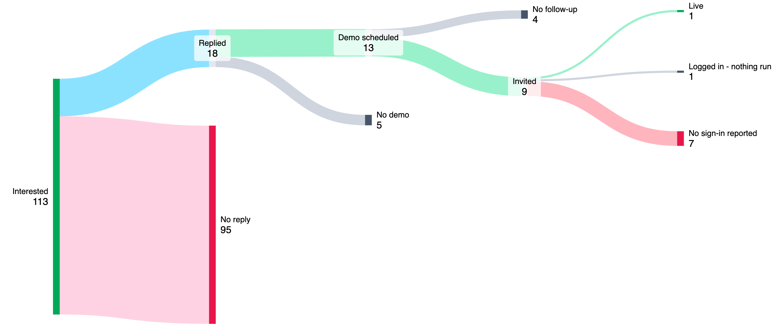
AgentScore
Weekly update
Oct 29 - Nov 4, 2026
7 of 9 invited: no sign-in reported
No response. Companies, as of Nov 4
No follow-up
4
Live
1
Replied
18
Demo scheduled
13
Logged in - nothing run
1
Invited
9
No demo
5
No sign-in reported
7
Interested
113
No reply
95
Of the 9 invited: Tritusa live, Wolters Kluwer reported logged in with nothing run, 7 no sign-in reported (4 invited Oct 12, 3 invited Nov 2).

Slide 6
AgentScore
Weekly update
Oct 29 - Nov 4, 2026
Signups: about 1 a day outside the three Transform events
Lack of signups. Labs form submissions per day (people, not companies), Aug 19 - Oct 30
Transform Dallas (Aug 20)
Transform London (Oct 22)
Transform Singapore (Sep 17)
140 dated Labs form submissions. 77 (55%) came on the three event days: 38 on Aug 20, 15 on Sep 17, 24 on Oct 22 (7 more on Oct 21).
The other 63 came over 70 days, 0.9 a day. The overall average with the event days is 1.9.
Dashed line: average outside event days, 0.9 a day

Slide 7
AgentScore
Weekly update
Oct 29 - Nov 4, 2026
Feedback from people using it
Tritusa ran its agents and they scored well. What they want now is help using the score.
TRITUSA, EMAIL TO ANDREW
TOP ASKS ACROSS ACCOUNTS
"We evaluated our AI agents today with proper traces, and they scored well in AgentScore."
Simulation testing and multi-agent scoring lead the list
They asked for a demo or training session on:
1. How AgentScore evaluates agents and calculates scores
2. Guardrails and configuration parameter setup
3. How to identify failures and improve scores
4. Best practices for agent evaluation
5. Report and recommendation generation
Simulation testing 6 accounts
Meta, L'Oréal, Tritusa, Eaton, PG&E, Accenture
Score a group of agents or a workflow 5 accounts
Meta, Wolters Kluwer, Aptiv, Eaton, Accenture
Access control and self-service onboarding 3 accounts
Wolters Kluwer, L'Oréal, Accenture
Export of traces and scores 3 accounts
Wolters Kluwer, Tritusa, Accenture
Cost and token report per agent 3 accounts
L'Oréal, Tritusa, Meta
CI/CD release gate 2 accounts
Eaton (headline requirement), Accenture
Jawahar Govindaraj. Teams are in Australia and India, so they asked for Mon-Thu slots at 8 AM or 8 PM EDT.
Tritusa email from Jawahar Govindaraj to Andrew. Customer Feedback Log, High-priority feature requests, by number of accounts.

Slide 8
AgentScore
Weekly update
Oct 29 - Nov 4, 2026
What is next
The three priorities from the draft roadmap (Nov 4), with this week's actions
SIMPLER ONBOARDING
EVERY INTERNAL AGENT
SPIKES
Get every user to a first score
Score every internal Tricentis agent
JEV / decision models and stimulation testing
Guided first session
Every screen offers one next action until the user reads a score and a verdict. No traces, profiles or evals to set up on the way.
Gaps still open
Home does not open the connect card, the first score does not start on its own, and verdict names differ by screen.
This week
Design improved flow and identify gaps.
Adoption, not product work
Connect and score each internal Tricentis agent. No new AgentScore feature is expected.
Where it stands
Only the Tosca agent (ATA) scores today. Owning teams need to set an agent-name attribute on their spans.
This week
Tim pushes the Performance Agent span-attribute PR. Product and Tim meet the agent owners and write a one-page instrumentation guide.
JEV / decision model
A hybrid scorer: the cheaper model where it fits the check, the full judge where it does not. Cuts scoring time and cost.
Stimulation testing
Profile the agent, run targeted tests, score the results and generate improvements, without waiting for real traces.
Why now
Simulation testing is the top ask (6 accounts).
Also this week: Product writes the legal brief on AI Workspace opt-in, plus a charge / no-charge map. Also on Now: workflow grouping.
Roadmap Nov 4, draft. Working sessions Oct 29, Nov 2 and Nov 3.

